Slide 1
NITRO: A Framework for Adaptive Code Variant Tuning
Saurav Muralidharan, Manu Shantharam, Mary Hall, Michael Garland*, Bryan Catanzaro*
University of Utah and *NVIDIA Research

Slide 2
Disclaimers
This research was funded in part by the U.S. Government. The views and conclusions contained in this document are those of the authors and should not be interpreted as representing the official policies, either expressed or implied, of the U.S. Government.
This research was funded by DARPA contract HR0011-13- 3-0001.
Co-authors of this paper own stock in NVIDIA Corporation

Slide 3
Motivation
Some computations may have many implementations
  Example: BFS, SpMV, Solvers, Sort etc.
  Performance of implementations may depend on input and architecture
  Set of implementations constitutes a ‘search space’
Best implementation may not be known till runtime
This paper describes a framework that tries to dynamically select the best implementation

Slide 4






Sparse Matrix-Vector Multiplication
      Sparse matrices represented using many formats
      Example formats: Compressed Sparse Row (CSR), DIA etc.
      Optimized implementations exist for each format
      Exploit as much structure of the matrix as possible
      Running Example: SpMV implementations in CUSP library
DIA
CSR-VEC
ELL

Slide 5
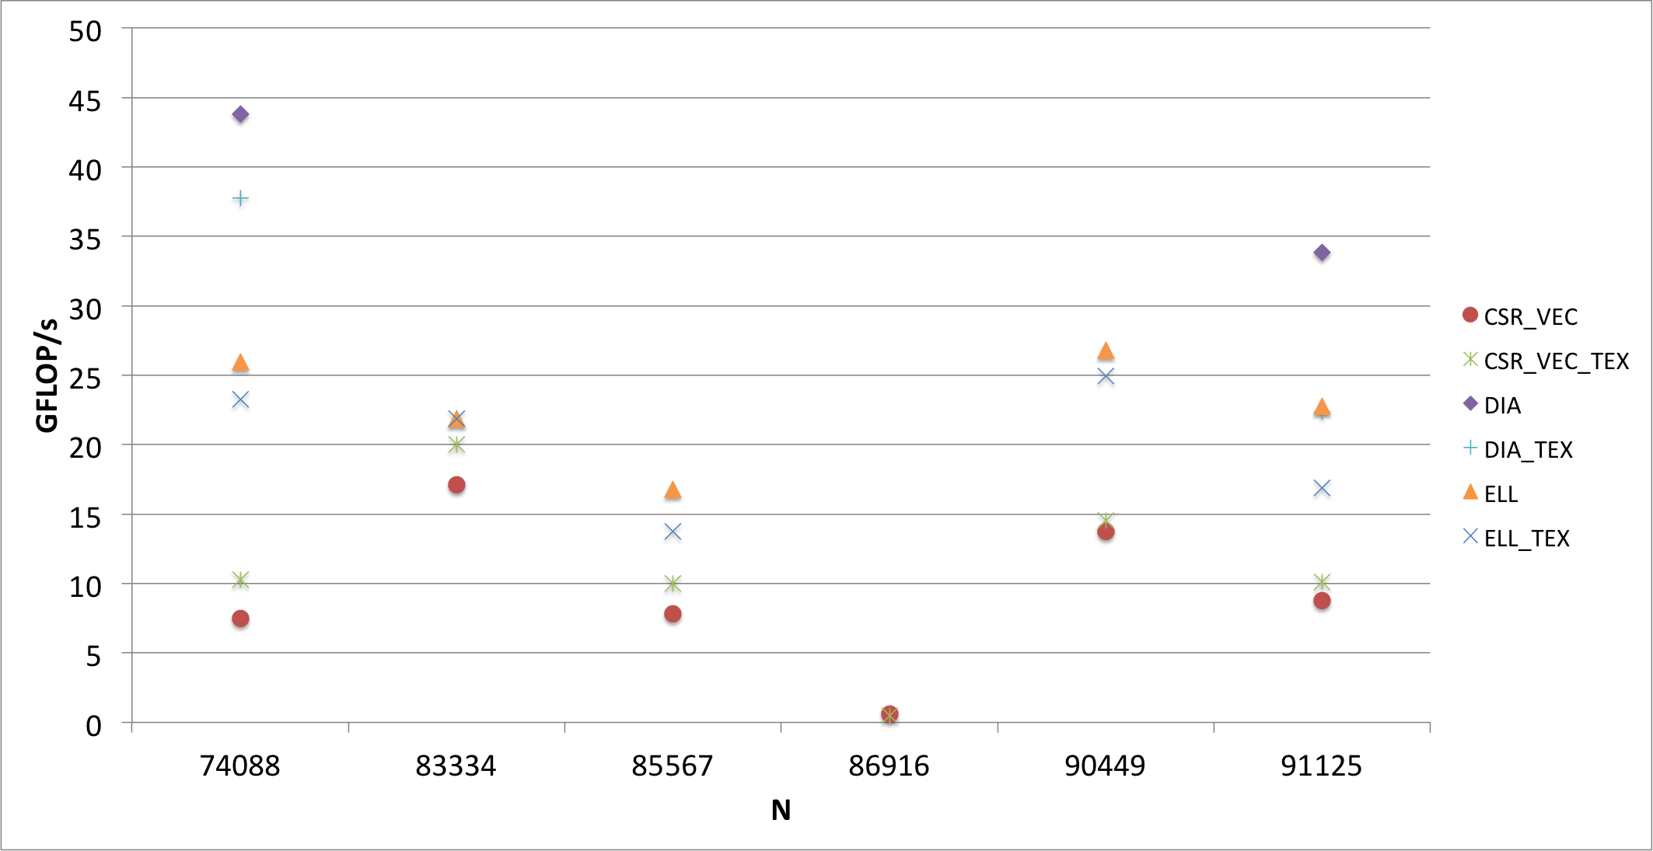
Input Dependence in SpMV

Slide 6
Autotuning Systems
Navigate a search space of:
  Parameters
  Implementations, a.k.a ‘Code Variants’
Objective: Find the best ‘point’ in search space
  According to some optimization criteria
  Usually Performance
Why autotuning?

Slide 7
Tuning Code Variants
Parameter tuning systems
Can we tune variants using parameter tuning systems?
  How do we ‘prune’ the search space?
  Most information known only at runtime
  Do we run search heuristic on every execution of program?
  We need some sort of ‘model’ or mapping
param_1
Search Space
param_1: 5.0
param_2
Search Heuristic
param_2
param_2: 3.5
param_1

Slide 8
Nitro: Introduction
    What is Nitro?
Goal: Provide general productivity tool for experts
  Both library and application developers
Some Terminology
  Model:
  Feature: Characteristic or property of input data
  Constraint: A check to prevent execution of invalid variant
Programmer-directed code variant tuning framework
Infers mapping: inputs ➔ variants
Uses mapping to select variants @ runtime
Input features
Variant label

Slide 9

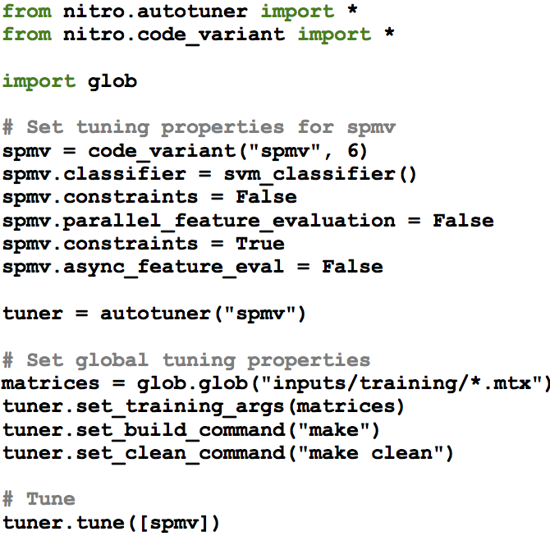

Tuning Process Overview
Library Driver (C++)
Tuning Script
(Python)
Training Inputs
Active Learner
Feature Evaluator
Nitro Tuning Subsystem
Classifier
Constraint Evaluator
Models
Models

Slide 10
Nitro Production Use
User Library (my_lib)
Nitro Library
SpMV (...)
CSR_VEC
DIA
ELL
...
F₁ | F₂ | … | … | F_{j}
C₁ | C₂ | … | … | C_{k}
SpMV (...)
CSR_VEC
DIA
ELL
...
F₁ | F₂ | … | … | F_{j}
C₁ | C₂ | … | … | C_{k}
my_lib::SpMV(matrix);
DIA
Run DIA
Query
Models
SpMV Model
End User
User Library

Slide 11
SpMV Library Driver (C++)
// Create Nitro tuning context
context cx;
...
code_variant<tuning_policies::spmv,
ArgTuple> spmv(cx);
// Declare and add variants
csr_vector_type<T> csr_vector_variant;
dia_type<T> dia_variant;
...
spmv.add_variant(&csr_vector_variant);
spmv.add_variant(&dia_variant);
Auto-Generated from Tuning Script
thrust::tuple of Variant Args
C++ Functor Containing DIA Variant

Slide 12
SpMV Library Driver (C++)
// Declare and add features...
avg_nnz_per_row_type<T> avg_nnz_feature;
...
spmv.add_input_feature(&avg_nnz_feature);
...
// ... and constraints
dia_cutoff_type dia_cutoff;
spmv.add_constraint(&dia_cutoff);
...
// Call variant
spmv(input_matrix);
Padding estimate for conversion to DIA Format

Slide 13
SpMV Tuning Script (Python)
# Provide application, fn name, number of variants
tuner = autotuner(“spmv”)
spmv = code_variant(“spmv”, 6)
# Set variant-specific tuning options
spmv.classifier = svm_classifier()
spmv.constraints = True
# Provide training data for classifier
tuner.set_training_args(input)
# Perform autotuning of variant
tuner.tune([spmv])

Slide 14
Model Construction
Tuning subsystem builds a model that maps a given feature vector to label corresponding to optimal variant
Offline training phase
Plug-in support for classifiers
Support Vector Machines (using libSVM) is currently used by default:
  RBF Kernel is default; parameters found using cross-validation based parameter search
Training Inputs
Labeled Training Data
DIA
CSRV
Exhaustive Search
Feature & Constraint Evaluation

Slide 15
Improving Training & Runtime Overheads
Incremental tuning through Active Learning
Parallel feature and constraint evaluation
Asynchronous feature function execution
Active Pool
Training Pool
BvSB Pick
Retrain
Model

Slide 16
Experimental Setup
Target architecture: Tesla C2050 (Fermi)
Training inputs
  Taken from standard sets
  Exemplar input for each variant (minimally)
Test inputs
  Distinct from training data
  Test set much larger than training set to test generalization

Slide 17
Benchmarks
Benchmark | Variants
SpMV (CUSP) | CSR Scalar (Tex/Non-Tex) CSR Vector (Tex/Non-Tex), ELL, DIA
Pre-Conditioner+Solver (CULA) | (CG, BiCGStab) Solvers (Jacobi, Blocked Jacobi, FAInv) Pre-conditioners
BFS (Back40Computing) | E-C (Fused/Iterative) C-E (Fused/Iterative) 2-Phase (Fused/Iterative)
Histogram (CUB) | (Sort, Global-Atomic, Shared-Atomic) Variants (Even-Share, Dynamic) Grid Mappings
GPU Sort (CUB, ModernGPU) | Merge, Locality, Radix
Features specific to each benchmark; details in paper

Slide 18
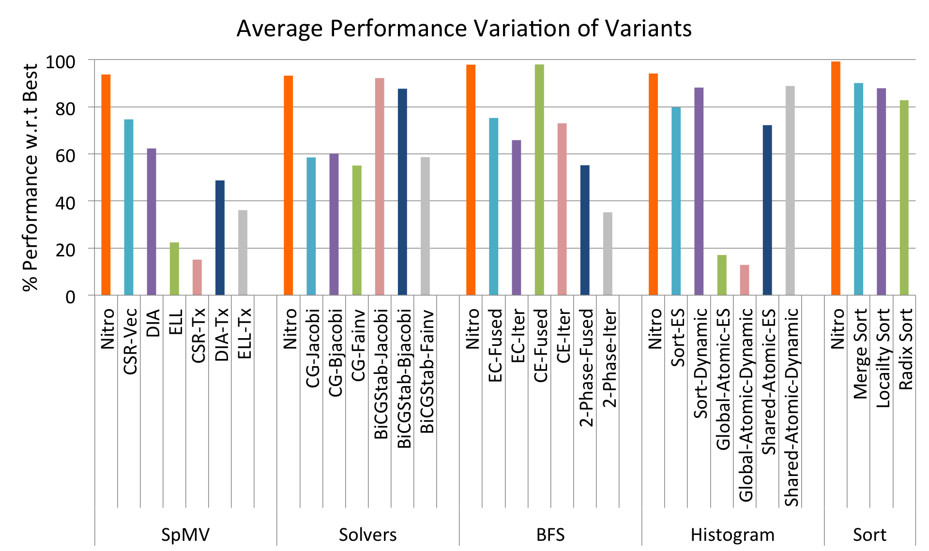
Results: Nitro vs. Other Variants
On average, Nitro achieves at least 93% performance w.r.t exhaustive search

Slide 19
Performance Breakdown
~ 80% of test set achieves at least 90% of performance.

Slide 20
Results: Incremental Tuning
Achieves 90% of performance of full training set in ~ 25 iterations

Slide 21
Related Work
Variant Tuning Systems: PetaBricks, STAPL etc.
  Tuning based on general input characteristics
Parameter Tuning Systems: Active Harmony, Orio etc.
Domain-Specific Autotuners: OSKI, SPIRAL, etc.
Other Solutions to Algorithm Selection Problem
  MDP, Reinforcement Learning etc.
  Can be integrated into Nitro’s learning sub-system

Slide 22
Conclusions & Future Work
Nitro
  Programmer-directed code variant tuning system
  Uses supervised learning to select variants based on input dataset features
  For 5 high-performance GPU benchmarks, Nitro-tuned variants achieve over 93% of performance w.r.t exhaustive search
  Incremental tuning supported via Active Learning
Future Work
  Automatic variant generation from high-level specifications
  Architectural features & features derived from compiler analysis
  Tunable parameter support

Slide 24
Feature Evaluation Overhead
Analysis helps remove features with high asymptotic complexity

Slide 25
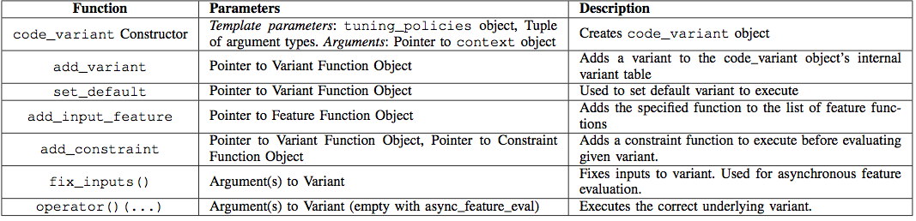
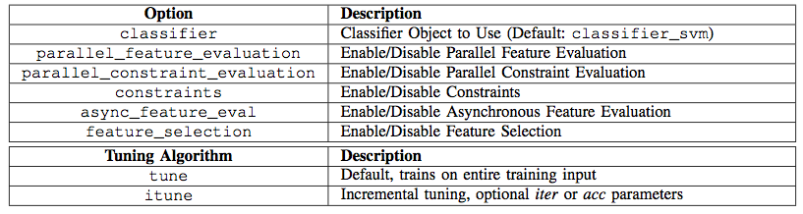
Library and Tuning Interfaces

Slide 26
Benchmarks: Features
Sparse Matrix-Vector Multiplication
  AvgNZPerRow, RL-SD, MaxDeviation, DIA and ELL Fillin
Pre-conditioner + Solvers
  NNZ, #Rows, Trace, DiagAvg, DiagVar, DiagDominance, LBw, Norm1
Breadth-First Search
  AvgOutDeg, Deg-SD, MaxDeviation, #Vertices, #Edges
Histogram
  N, N/#Bins, SubSampleSD
GPU Sort
  N, #Bits, #AscSeq

